Slide 1
Hello everyone

Slide 2
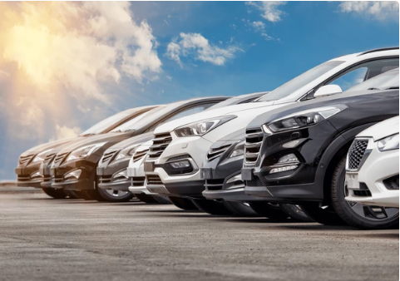
Analyzing the Impact Of Car Features on Price and Profitability

Slide 3
Project description
This project aims to analyze the impact of car features on price and profitability within the automotive industry.
By examining various car features and their influence on pricing strategies and profitability, the project seeks to provide insights to car manufacturers for making informed decisions regarding product development, pricing, and market positioning.
Assumptions:
Dataset represents the broader automotive market.
Relationships between car features, pricing, and profitability are generalizable across different market segments.
Data collected is accurate and complete.

Slide 4
approach
Data
Understanding
Reviewed the data structure and column headers
Calculated summary statistics.
Data
Cleaning
Handled missing values and outliers.
Data
Analysis
Descriptive Analysis
Data
Visualization
Ensured data integrity for accurate analysis.
Regression Analysis
Market Segmentation
Created various charts and graphs to visualize relationships and patterns in the data.
Optimization

Slide 5


tech-stack used
Microsoft Excel 2021
Microsoft PowerPoint 2021
For Data cleaning
Data Analyzing
Data Visualizing
Dashboard
Presentation

Slide 6
Dataset description
The dataset contains information on over 11,000 car models.
It includes 16 variables such as make, model, year, fuel type, horsepower, transmission type, number of cylinders, market category, size, style, MPG, popularity, and MSRP.
It provides insights into traditional gasoline-powered cars, as well as emerging technologies like electric and hybrid vehicles.
Last updated in 2017, may not reflect the most recent trends or prices in the automotive industry.
Overall, this dataset could be a valuable resource for data analysts interested in exploring various aspects of the automotive industry and could provide insights that could inform decisions related to product development, marketing, and pricing.
MPG: Miles per gallon; MSRP: Manufacturer's suggested retail price.

Slide 7

Significance of variables
MAKE AND MODEL: Identify the brand and specific model of each car.
YEAR: Indicates the release year of each car model.
ENGINE SPECIFICATIONS: Indicates performance characteristics such as horsepower, cylinders, and fuel type.
TRANSMISSION TYPE: Provides critical information about how power is transmitted from the engine to the wheels.
MARKET CATEGORY: Provides valuable insights into how car models are positioned within the automotive market.
FUEL EFFICIENCY: Estimates the fuel efficiency of each car model through variables like highway and city MPG(Miles Per Gallon).
VEHICLE SIZE AND STYLE: Provides the physical dimensions and aesthetics about car model.
POPULARITY: Ranks the popularity of car models.
MANUFACTURER ‘S SUGGESTED RETAIL PRICE(MSRP): Indicates the suggested retail price for each car model .

Slide 8
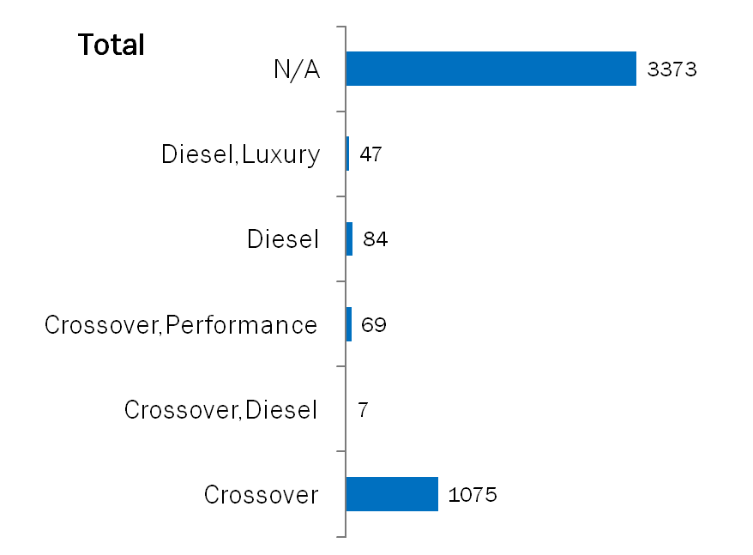
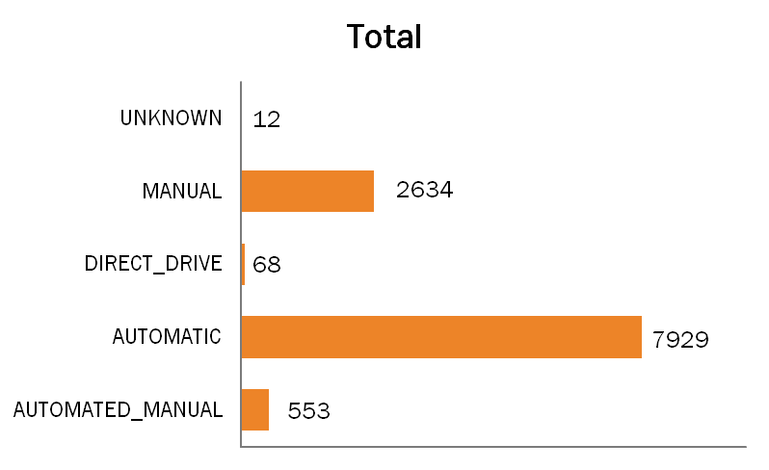
ANOMALIES
Transmission Type
Market Category
12 instances are classified as 'unknown,' indicating missing of available information for these specific brand models.
3373 instances are classified as 'N/A,‘
indicating lack of available information on categorization of these specific car models.

Slide 9
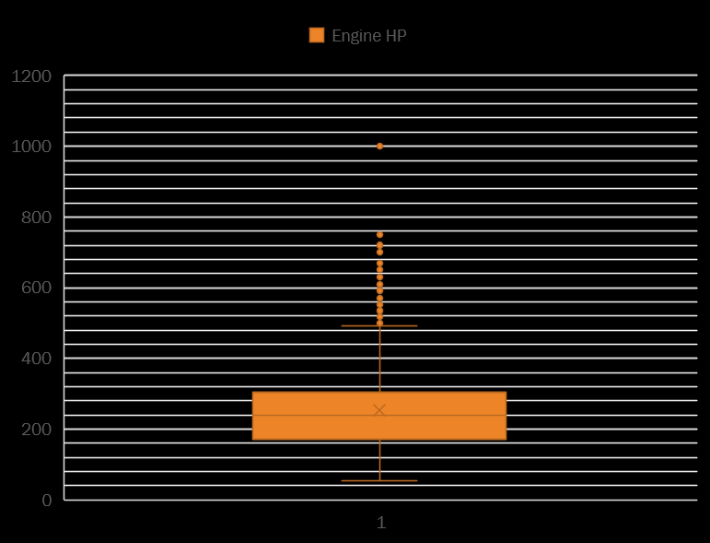
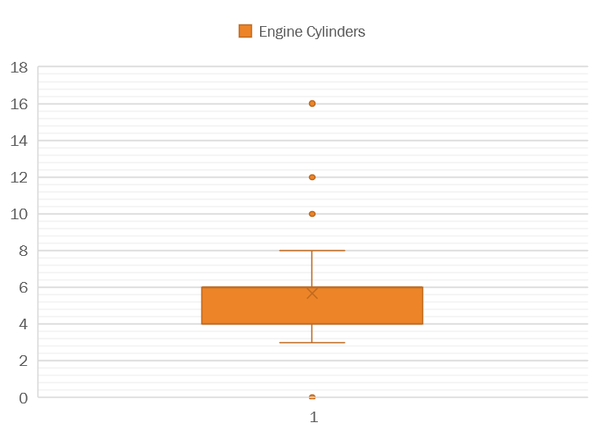
outliers
Removing outliers, including Bugatti cars with exceptionally high horsepower, could significantly impact the analysis and insights, as they contribute valuable information to the dataset
Removing outliers from engine cylinders poses challenges as it may eliminate entire categories like electric cars (0 cylinders) or high-performance cars like Bugatti (16 cylinders).

Slide 10
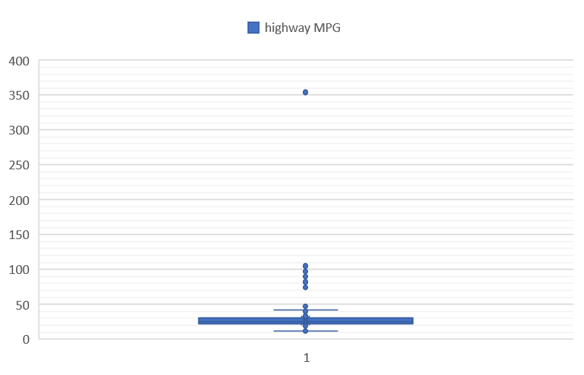
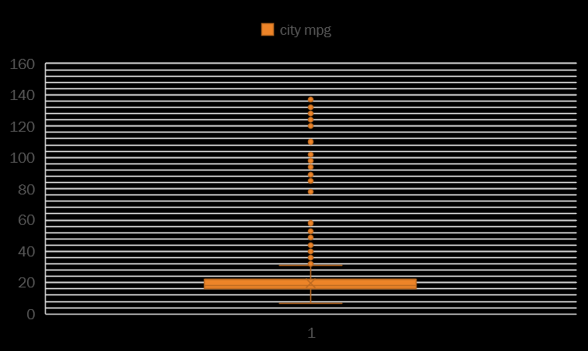
outliers
Removing the outlier with an unrealistically high highway MPG value of 354 for the Audi A6, as it likely indicates an anomaly.
City MPG contains numerous outliers, but removing them may lead to loss of valuable information or bias in the analysis.

Slide 11
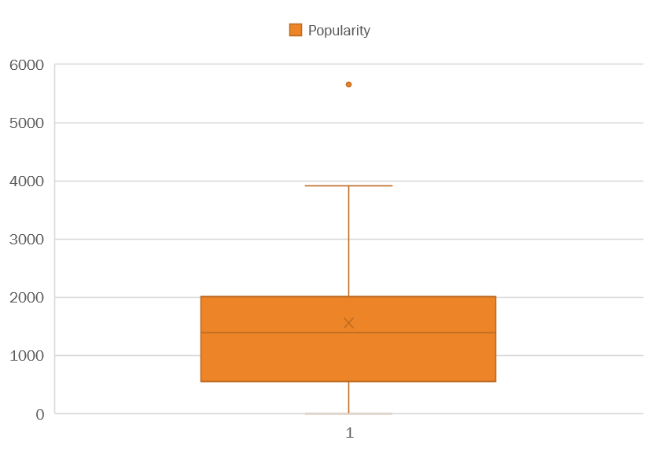
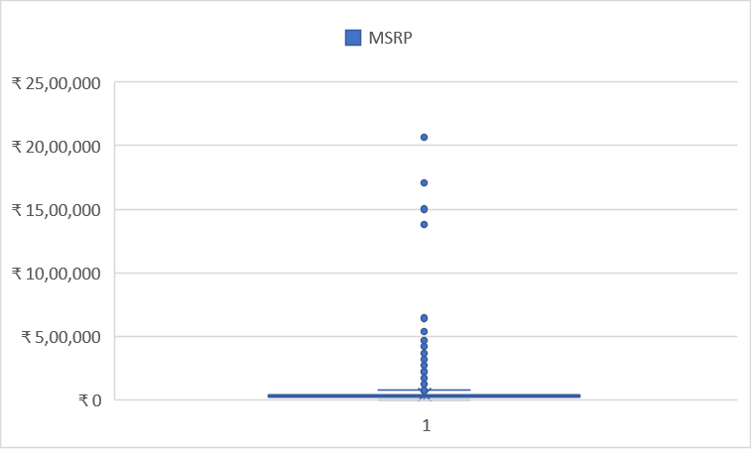
outliers
Removing outliers in the popularity variable would result in removing all Ford brand cars.
Removing outliers from the MSRP variable may lead to loss of valuable information or bias in the analysis, as luxury or high-performance cars often have significantly higher prices.

Slide 12
DATA CLEANING
NUMBER OF DOORS: Utilized online sources to gather information on missing values for the brands: Ford Model FF and Tesla Model.
TRANSMISSION TYPE: Performed mode imputation by replacing abnormal data point "Unknown" with the mode value "Automatic" .
ENGINE HP: Null values in the engine horsepower variable were filled using data gathered from reliable online sources and through pivot tables, ensuring data completeness and accuracy.
ENGINE FUEL TYPE: Removed three rows with null values in the engine fuel type variable, all belonging to one vehicle (Suzuki).
ENGINE CYLINDERS: Filled null values in the engine cylinders variable with 0, as the corresponding vehicles with missing cylinder values were electric or Mazda RX7 and RX8, which do not have traditional cylinder configurations.
Deleted 715 duplicated rows from the dataset to ensure data integrity and accuracy in the analysis.

Slide 13




tasks
TASK 1
TASK 2
TASK 3
TASK 4
Analyzing trends in car features and pricing over time.
Comparing the fuel efficiency of different types of cars.
Investigating the relationship between a car's features and its popularity.
Predicting the price of a car based on its features and market category.

Slide 14
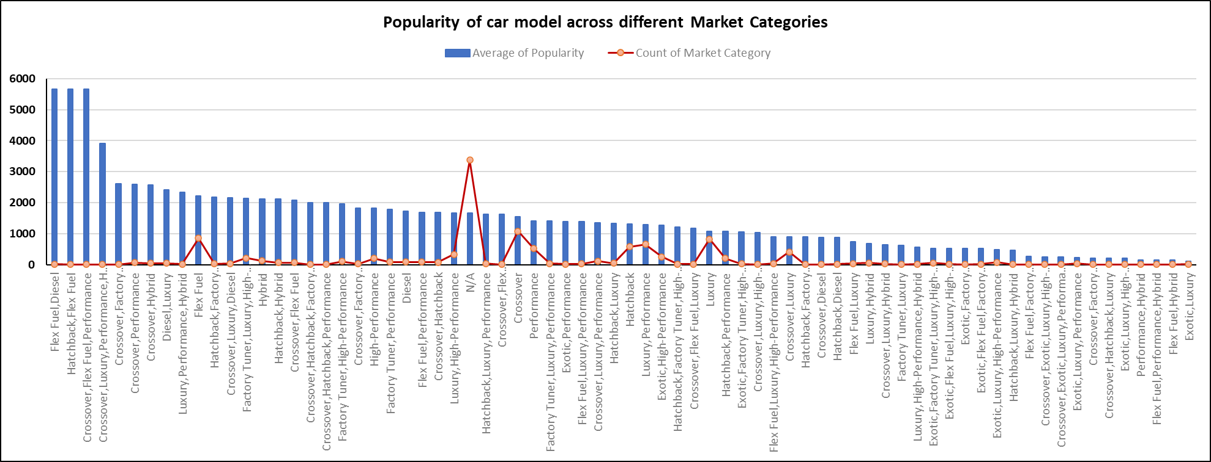
How does the popularity of a car model vary across different market categories?
Flex fuel(DIESEL), crossover flex fuel, and hatchback flex fuel categories exhibit high average popularity.
Exotic and luxury cars tend to have the lowest popularity ratings.

Slide 15
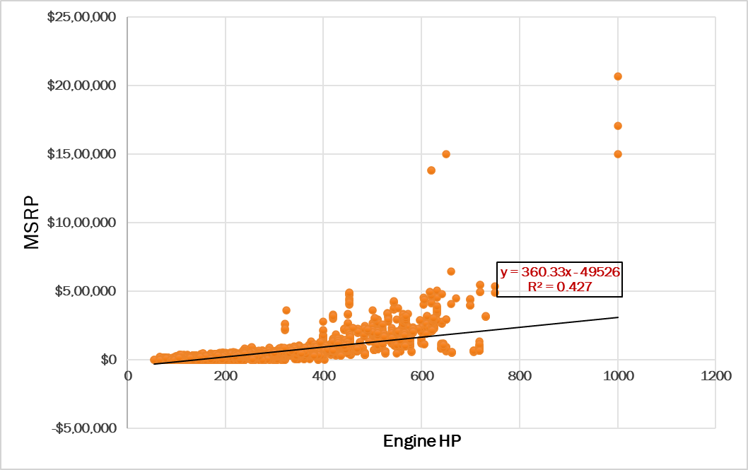
What is the relationship between a car's engine power and its price?
Higher the engine
horsepower, higher the car price.

Slide 16
Which car features are most important in determining a car's price?
Higher MPG (both highway and city) and popularity are associated with lower car prices.
More doors are linked to lower prices.
Higher engine horsepower, more engine cylinders, and newer model years tend to increase car prices.

Slide 17
How does the average price of a car vary across different manufacturers?
Bugatti's reputation for producing some of the most luxurious and expensive cars in the world contributes to its higher average price compared to other automotive brands.

Slide 18
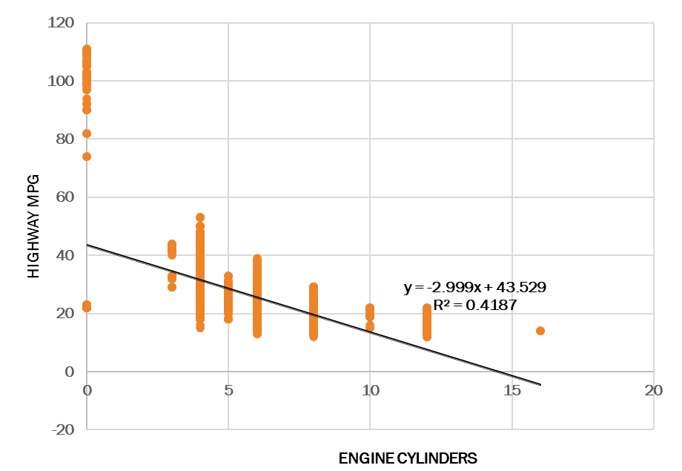
What is the relationship between fuel efficiency and the number of cylinders in a car's engine?
More the engine cylinders, lower the
highway MPG, with each additional cylinder
leading to a decrease in highway fuel efficiency.

Slide 19

KEY TAKEAWAYS
Cars with powerful engines typically command higher prices.
Cars with higher MPGs and popularity are inversely related with car prices.
A trend observed suggests that as the number of doors in a car increases, there is a tendency for the price to decrease.
Higher engine horsepower, more engine cylinders, and newer model years tend to increase car prices.
As the number of cylinders in a car's engine increases, the highway MPG tends to decrease.
Luxury and exotic cars may have lower average popularity despite their premium status.

Slide 20

recommendations
Consider price adjustments for fuel-efficient and popular cars to appeal to budget-conscious consumers.
Explore pricing adjustments for cars with more doors to appeal to price-sensitive buyers.
Emphasize the value proposition of cars with higher engine power, cylinders, and newer model years to justify higher prices.
Highlight the benefits of cars with fewer engine cylinders despite potential lower highway MPG.
Develop and market high-performance cars with powerful engines to justify premium pricing.
Continuously monitor market trends to adapt pricing, marketing, and product strategies to evolving consumer preferences.

Slide 21
LIMITATIONS
The dataset may not reflect the most recent trends or prices in the automotive industry, as it was last updated in 2017.
The analysis relies on certain assumptions about data quality, relationships between variables, and the appropriateness of analytical methods used.
Challenges
Handling outliers in the dataset requires careful consideration to ensure data integrity without compromising analytical insights.
Dealing with missing values poses a challenge in maintaining dataset integrity and mitigating bias, necessitating robust strategies for imputation.

Slide 22

conclusions
Through a comprehensive analysis encompassing critical automotive factors including engine power, fuel efficiency, market categories, and pricing dynamics, this project unveils invaluable insights crucial for informed decision-making within the automotive industry.
Leveraging these insights empowers manufacturers to optimize product development, fine-tune pricing strategies, and tailor marketing endeavors, thereby adeptly meeting consumer demand while maximizing profitability.
As the automotive landscape continues its evolution, the significance of continuous monitoring and adaptive strategies based on these insights cannot be overstated, essential for sustaining competitiveness and enduring success in the ever-changing marketplace.

Slide 23
Thank you…

